Slide 1
Big Data Analytics and Mining
Junming Shao

Slide 2
Lecture 2
Foundations of Data Mining

Slide 3
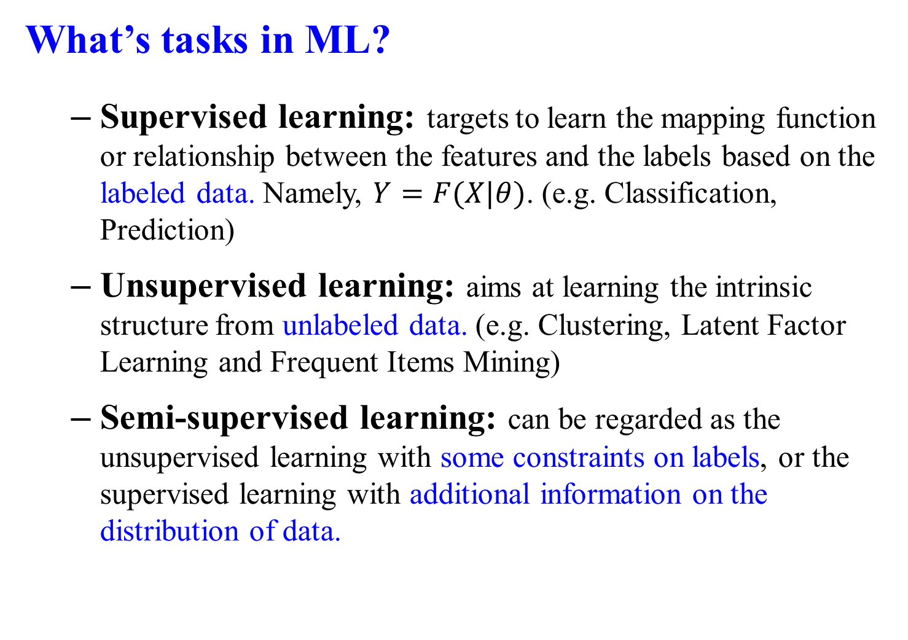
What’s tasks in ML?
Supervised learning: targets to learn the mapping function or relationship between the features and the labels based on the labeled data. Namely, $Y=F(X|θ)$. (e.g. Classification, Prediction)
Unsupervised learning: aims at learning the intrinsic structure from unlabeled data. (e.g. Clustering, Latent Factor Learning and Frequent Items Mining)
Semi-supervised learning: can be regarded as the unsupervised learning with some constraints on labels, or the supervised learning with additional information on the distribution of data.
Revisit: Classification-Clustering- Association Rule Mining- Outlier Detection

Slide 4
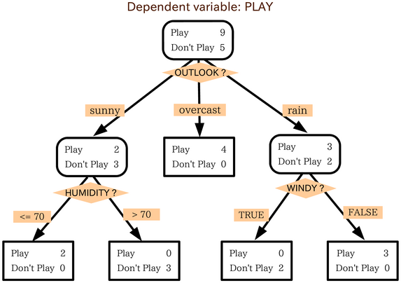
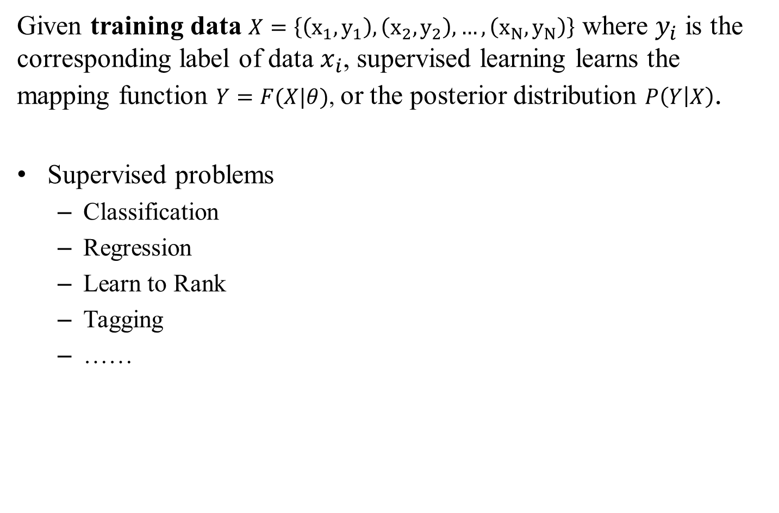
Supervised Learning
Given training data $X=\left\{\left(x_{1}, y_{1}\right),\left(x_{2},y_{2}\right),…,\left(x_{N},y_{N}\right)\right\}$ where $y_{i}$ is the corresponding label of data $x_{i}$, supervised learning learns the mapping function $Y=F(X|θ)$, or the posterior distribution $P\left(Y | X\right)$.
Supervised problems
Classification
Regression
Learn to Rank
Tagging
……

Slide 5
Example: Payment Prediction
Find the mapping function or model to answer whether one’s salary is more than 50k.
Age | Edu. year | HoursPerWeek | Pay
25 | 7 | 40 | <50k
38 | 9 | 50 | ≥50k
28 | 12 | 40 | ≥50k
24 | 10 | 40 | <50k
55 | 4 | 10 | ?

Slide 6
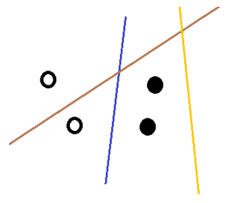
Example: If the solid points represent “salary < 50k” and hollow ones for “≥50k”, we can use the line to separate those points.
Which one is better?
Blue one
Why? → minimum error on predicted result (separate results)
A good model should minimize the loss on training data

Slide 7
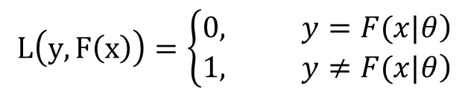

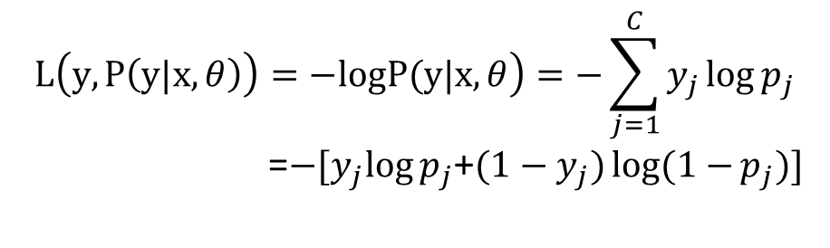
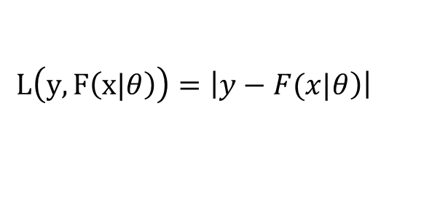

LOSS FUNCTION
To measure the predicted results, we introduce the loss function $L\left(Y,F\left(X|θ\right)\right)$, which a non-negative function
0-1 loss
Squared loss
Absolute loss
Log loss (Cross Entropy)
$$L\left(y,F\left(x\right)\right)=\left\{\begin{aligned}&\left.0, y=F(x|θ\right) \\ &\left.1, y≠F(x|θ\right)\end{aligned}\right.$$
$$L\left(y,F\left(x|θ\right)\right)={\left(y−F\left(x|θ\right)\right)}^{2}$$
$$L\left(y,F\left(x|θ\right)\right)=\left|\left.y−F(x|θ\right)\right|$$
$$\left.L\left(y,P\left(y|x,θ\right)\right)=−logP(y|x,θ\right)=−\sum_{j=1}^{C}{y_{j}\log{p_{j}}}$$
=$−{[y}_{j}\log{p_{j}}$+${(1−y}_{j})log(1−{p_{j})]}$

Slide 8
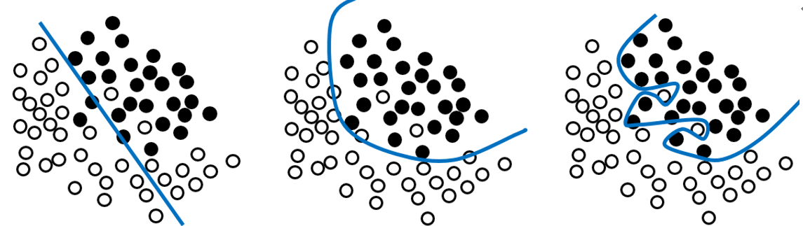
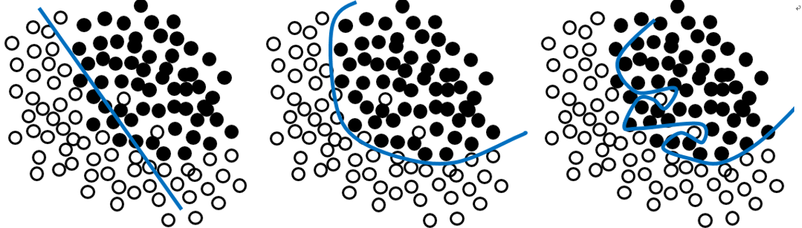
Training Loss and Test Loss
Training loss: loss on training data Test loss: loss on test data
Performance on training data of three models
Performance on training data and test data
Who wins?

Slide 9
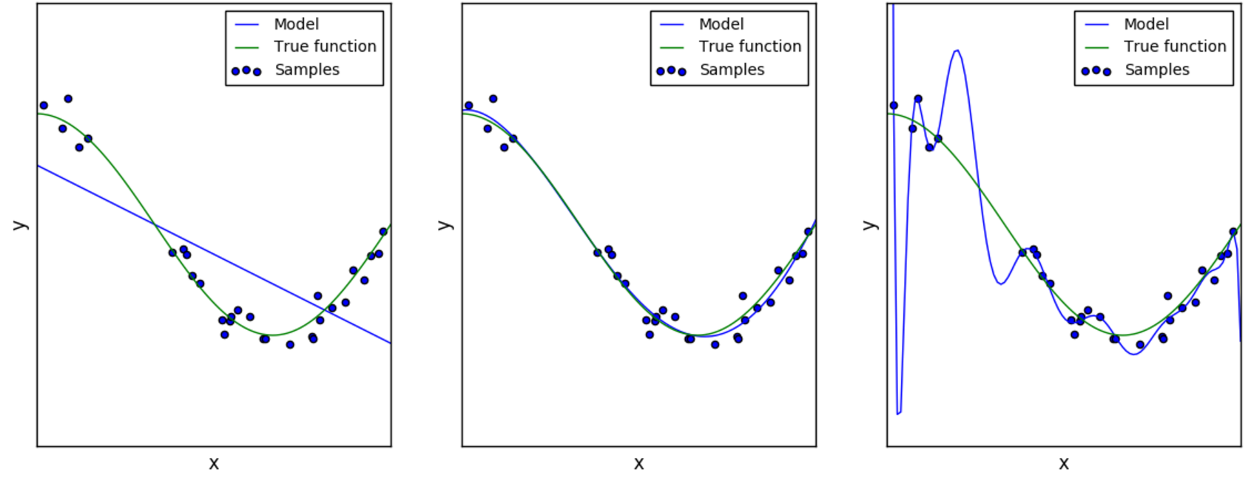
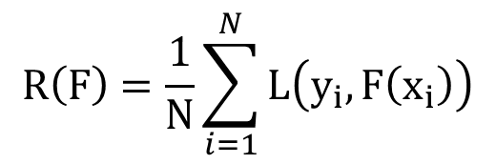
Generalization
Empirical risk:
Note: A good model cannot only take training loss into account and minimize the empirical risk. Instead, improve the model generalization.
$$R\left(F\right)=\frac{1}{N}\sum_{i=1}^{N}{L\left(y_{i},F\left(x_{i}\right)\right)}$$
Model Selection:
To avoid Underfitting and Overfitting

Slide 10
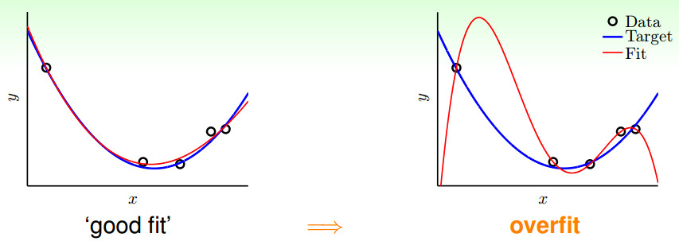
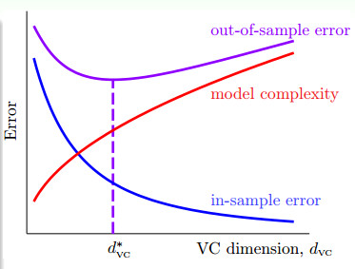
Strategy
Increase Sample
Remove Outliers
Decrease model complexity
Train-Validation-Test
Regularization
Source：http://jasonding1354.github.io/

Slide 11
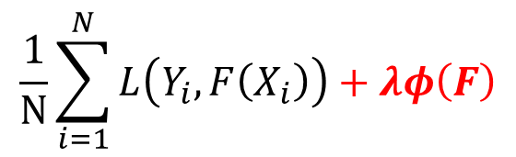
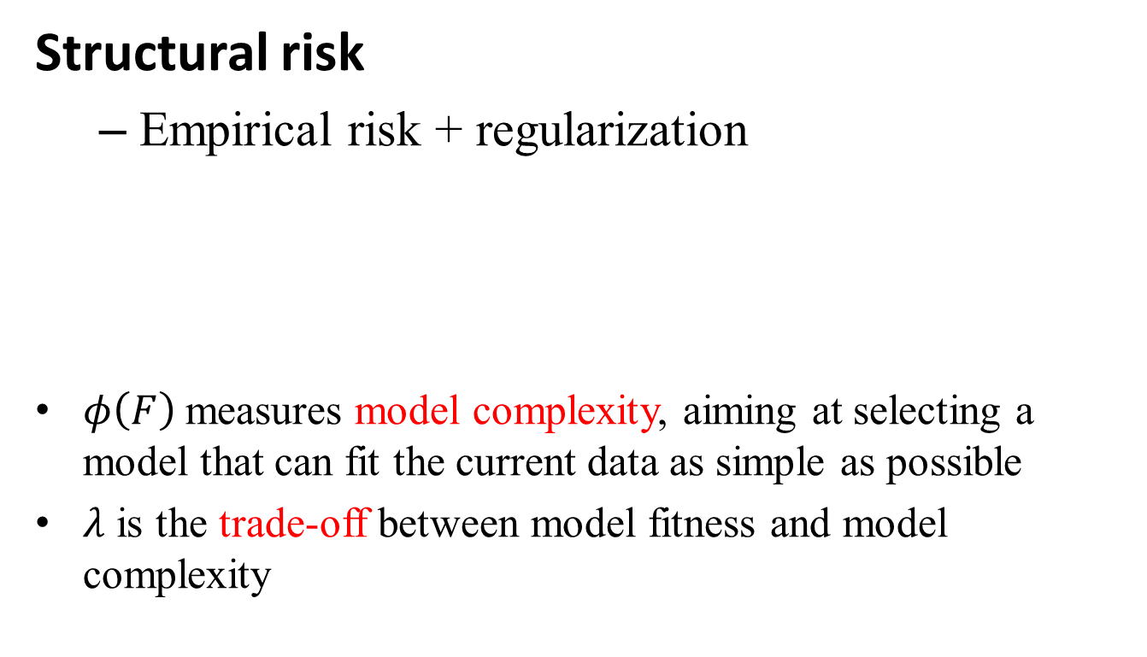
Model Selection and Regularization
Structural risk
Empirical risk + regularization
$φ\left(F\right)$measures model complexity, aiming at selecting a model that can fit the current data as simple as possible
$λ$ is the trade-off between model fitness and model complexity
$$\frac{1}{N}\sum_{i=1}^{N}{L\left(Y_{i},F\left(X_{i}\right)\right)+λφ\left(F\right)}$$

Slide 12
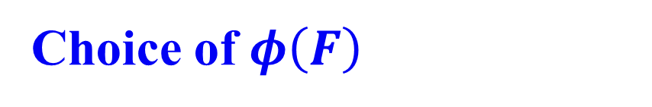

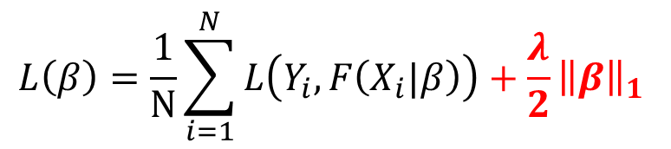
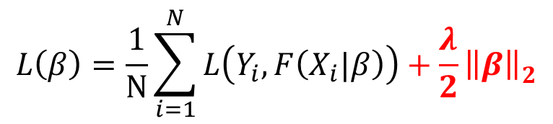
Choice of $φ\left(F\right)$
l₂ norm:
l₁ norm:
l_{2,1} norm, l_{1,2} norm, nuclear norm ${\left\|β\right\|}_{∗}$
$$L\left(β\right)=\frac{1}{N}\sum_{i=1}^{N}{L\left(Y_{i},F\left(X_{i}|β\right)\right)+\frac{λ}{2}{\left\|β\right\|}_{2}^{ }}$$
$$L\left(β\right)=\frac{1}{N}\sum_{i=1}^{N}{L\left(Y_{i},F\left(X_{i}|β\right)\right)+\frac{λ}{2}{{\left\|β\right\|}_{1}}^{ }}$$

Slide 13
Classification

Slide 14
1. Nearest Neighbor Classifiers
Basic idea: If it walks like a duck, quacks like a duck, then it’s probably a duck
Compute Distance
Test Record
Training Records
Choose k of the “nearest” records

Slide 15
Definition of Nearest Neighbor
K-nearest neighbors of a record x are data points that have the k smallest distance to x

Slide 16
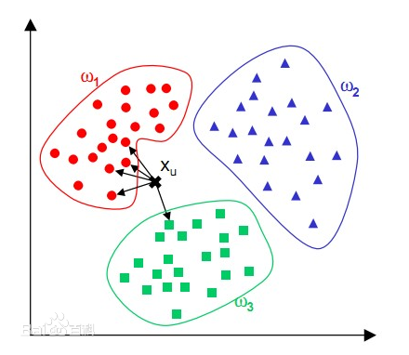
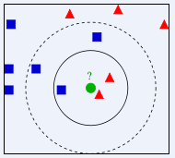
Predict class label of test instance with major vote strategy
KNN classifier
The effect of K

Slide 17
Remarks
Highly effective method for noisy training data
Target function for a whole space may be described as a combination of less complex local approximations
Learning is very simple (lazy learning)
Classification is time consuming
Difficult to determine the optimal k
Curse of Dimensionality

Slide 18
2. Naïve Bayes
Given training data X, posteriori probability of a hypothesis H, P(H|X), follows the Bayes theorem
Predicts X belongs to C₂ iff the probability P(C₂|X) is the highest among all the P(C_{k}|X) for all the k classes
Practical difficulty: require initial knowledge of many probabilities, significant computational cost

Slide 19
Class Conditional independent

Slide 20
Case Study
Spam Email Problem: classifying documents by their content: whether a document is a spam email or a non-spam email?
Namely, what is the probability that a given document D belongs to a given class C? In other words, what is ?
For spam email investigation, by Bayes' theorem, we have
where S means class of spam email and S^{c} is the class of normal email.

Slide 21
The problem is transferred to determine which posterior probability is much higher?
Since is a constant and is not relevant to S_{j} , the equation can be further written as:
The most common format
Given a document D, we can then use this formulas to determine whether it is a spam email or not.

Slide 22
To compute the posterior probability, we must first compute the prior probability and the conditional probability
Suppose we have already known the class information (spam or non-spam) of some emails (which are called as “training data”).
The can be easily obtained to compute based on the training data.
For , it can be computed as follows. As each document can be modelled as sets of words, the probability that a given document occurs in a document from class S_{j} can be written as

Slide 23
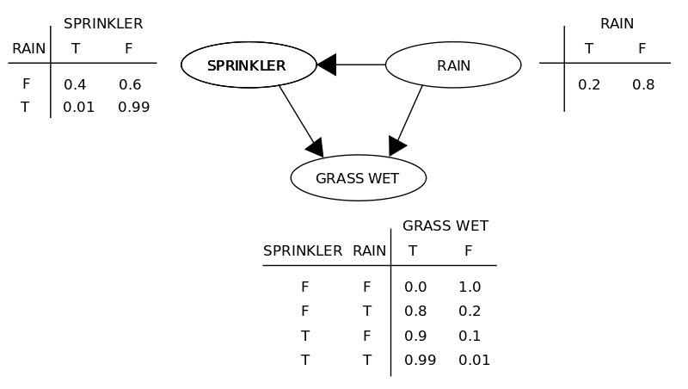
Independence Assumption
1、Naïve Bayes Classifier
2、Bayesian Network (without independence assumption)

Slide 24
Example of a Decision Tree
3. Decision Tree
categorical
categorical
continuous
class
Splitting Attributes
Refund
Yes
No
NO
MarSt
Single, Divorced
Married
TaxInc
NO
< 80K
> 80K
NO
YES
Training Data
Model: Decision Tree

Slide 25
Decision Tree Classification Task
Decision Tree

Slide 26
Apply Model to Test Data
Test Data
Start from the root of tree.
Refund
Yes
No
NO
MarSt
Single, Divorced
Married
TaxInc
NO
< 80K
> 80K
NO
YES

Slide 27
Apply Model to Test Data
Test Data
Refund
Yes
No
NO
MarSt
Single, Divorced
Married
TaxInc
NO
< 80K
> 80K
NO
YES

Slide 28
Apply Model to Test Data
Test Data
Refund
Yes
No
NO
MarSt
Single, Divorced
Married
TaxInc
NO
< 80K
> 80K
NO
YES

Slide 29
Apply Model to Test Data
Test Data
Refund
Yes
No
NO
MarSt
Single, Divorced
Married
TaxInc
NO
< 80K
> 80K
NO
YES

Slide 30
Apply Model to Test Data
Test Data
Refund
Yes
No
NO
MarSt
Single, Divorced
Married
TaxInc
NO
< 80K
> 80K
NO
YES

Slide 31
Apply Model to Test Data
Test Data
Refund
Yes
No
NO
MarSt
Single, Divorced
Married
Assign Cheat to “No”
TaxInc
NO
< 80K
> 80K
NO
YES

Slide 32
How to determine the Best Split
Before Splitting: 10 records of class 0, 10 records of class 1
Which test condition is the best?
Gini Index Entropy

Slide 33
Information Gain

Slide 34
Attribute Selection: Information Gain
Class P: buys_computer = “yes”
Class N: buys_computer = “no”

Slide 35
4. SVM
General Philosophy
Small Margin
Large Margin
Support Vectors

Slide 36
SVM—When Data Is Linearly Separable
w
There are infinite lines (hyperplanes) separating the two classes but we want to find the best one (the one that minimizes classification error on unseen data)
SVM searches for the hyperplane with the largest margin, i.e., maximum marginal hyperplane (MMH)

Slide 37
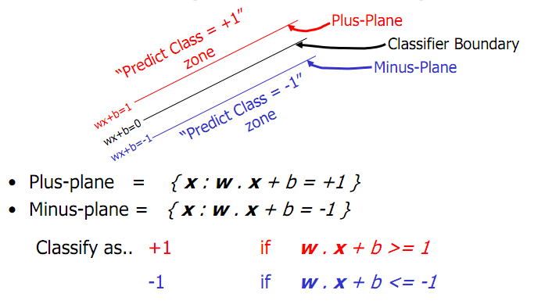
SVM—Linearly Separable

Slide 38
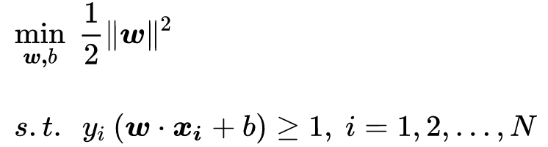
SVM—Linearly Separable
A separating hyperplane can be written as
W · X + b = 0
The hyperplane defining the sides of the margin:
H₁: w₀ + w₁ x₁ + w₂ x₂ ≥ 1 for y_{i} = +1, and
H₂: w₀ + w₁ x₁ + w₂ x₂ ≤ – 1 for y_{i} = –1
Any training tuples that fall on hyperplanes H₁ or H₂ (i.e., the sides defining the margin) are support vectors.
This becomes a constrained (convex) quadratic optimization problem:

Slide 39
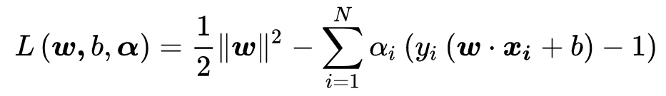


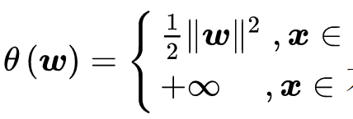



Constrained optimization problem to non-constrained problem with augmented Lagrangian multipliers
Let

Slide 40


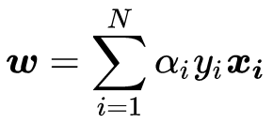
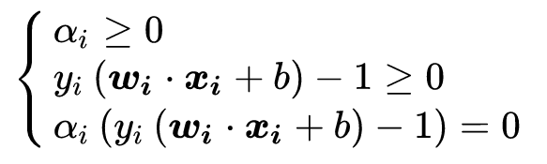
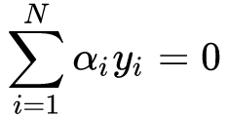
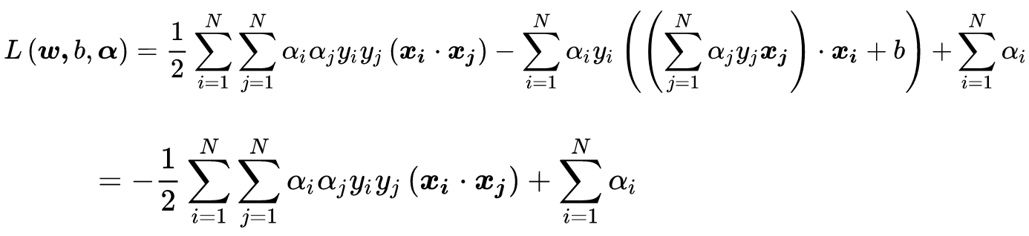
Lagrange duality
Convex
KKT
Dual form
KKT Conditions
Support vector

Slide 41
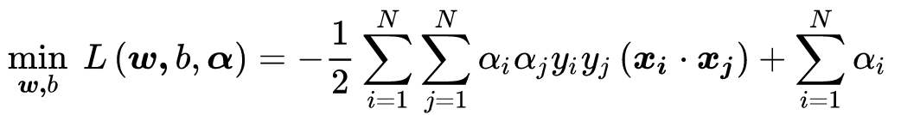
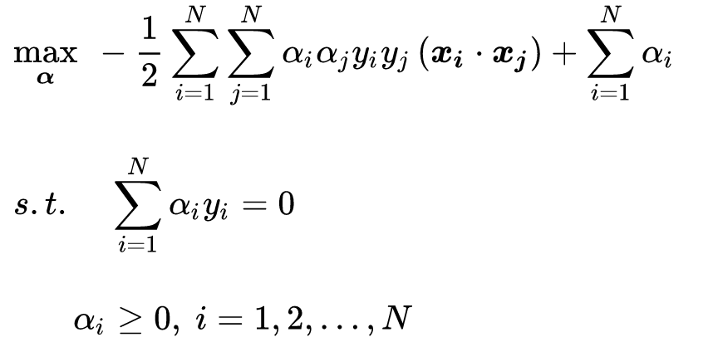

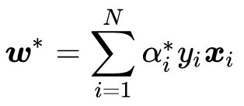
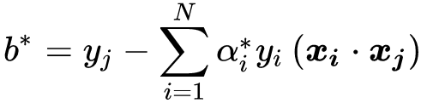
SMO Algorithm
SMO: Platt, John. "Sequential minimal optimization: A fast algorithm for training support vector machines." (1998).

Slide 42
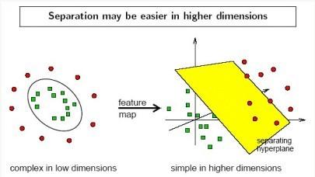
SVM—Linearly Inseparable
Transform the original input data into a higher dimensional space
Search for a linear separating hyperplane in the new space

Slide 43


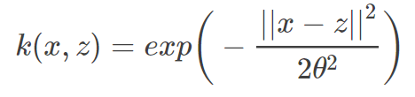
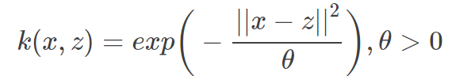

Kernel Trick
Instead of computing the dot product on the transformed data tuples, it is mathematically equivalent to instead applying a kernel function K(X_{i}, X_{j}) to the original data, i.e.,
Typical Kernel Functions
Polynomial kernel：
Gaussian kernel (RBF)：
Laplace kernel：
Sigmoid kernel：

Slide 44




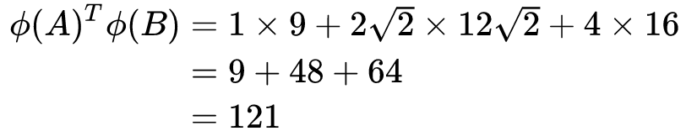
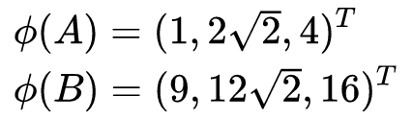
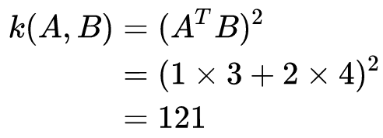
Kernel Function
Example:
Assume:

Slide 45
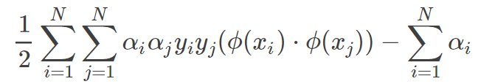
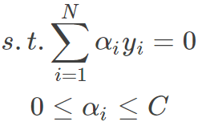
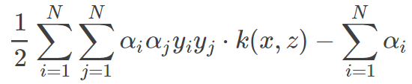
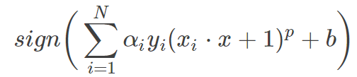

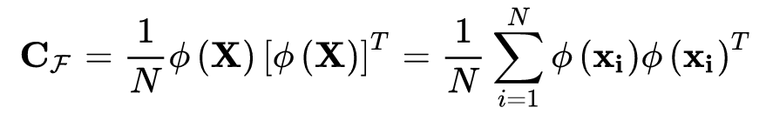
SVM—Kernel functions
SVM+ kernel
Objective function
Classifier
Kmeans + kernel
PCA + kernel

Slide 46
Thanks !!!

